Slide 1
ADA BOOST ALGORITHM

Slide 2
What is ADA Boost
Adaboost is short for “ADOPTIVE BOOSTING”
Adaboost is a meta-algorithm
Can be used with other learning algorithm to improve their performance.
It is a supervised learning algorithm that is used to classify data by combining multiple weak or base learners (e.g., decision trees) into a strong learner.
Key Concepts of ADABOOST:
Weak Learner: A model that performs slightly better than random guessing (commonly a decision stump — a one-level decision tree).
Boosting: An ensemble technique that combines multiple weak learners in sequence, where each learner focuses more on the mistakes of the previous ones.
Adaptive: It "adapts" by assigning more weight to misclassified instances in each iteration.

Slide 3
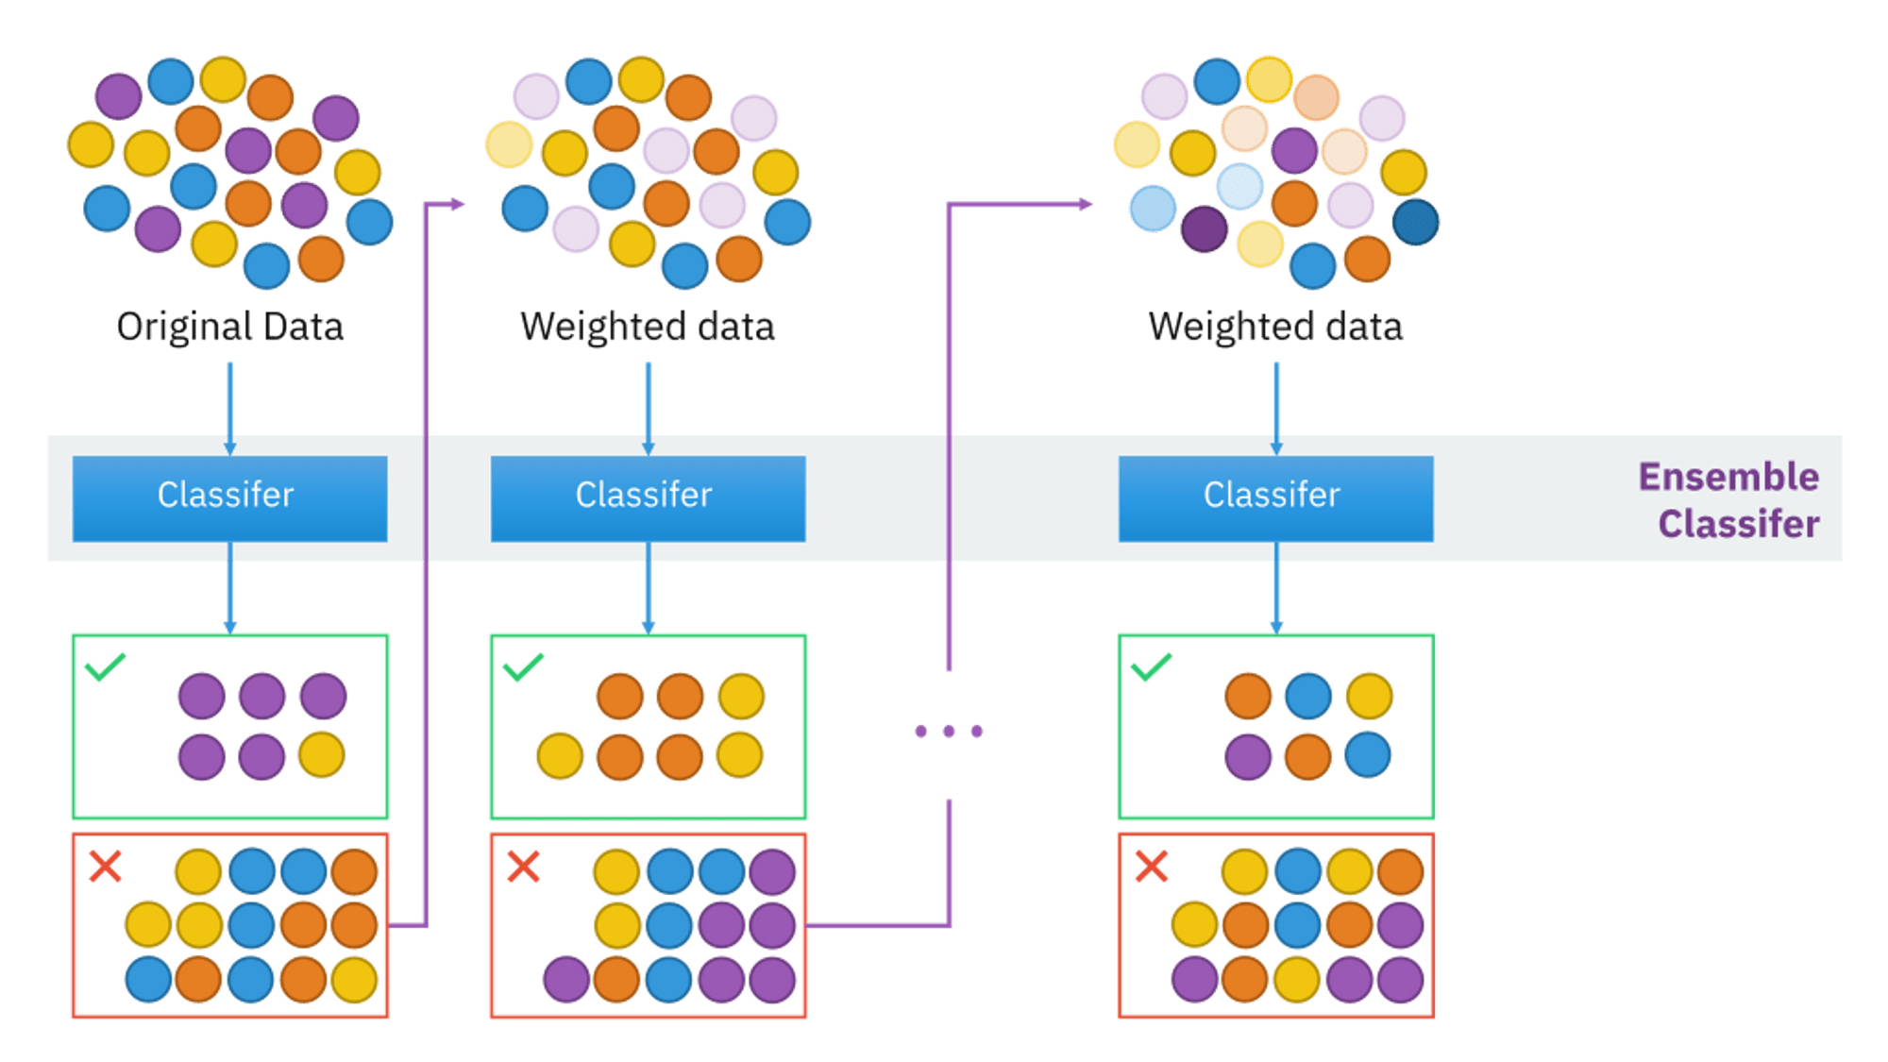
How Adaboost works

Slide 4
Use cases of Adaboost:
Adaboost are mainly used in following fields:
Spam detection
Face recognition
Text classification
Medical diagnosis

Slide 5
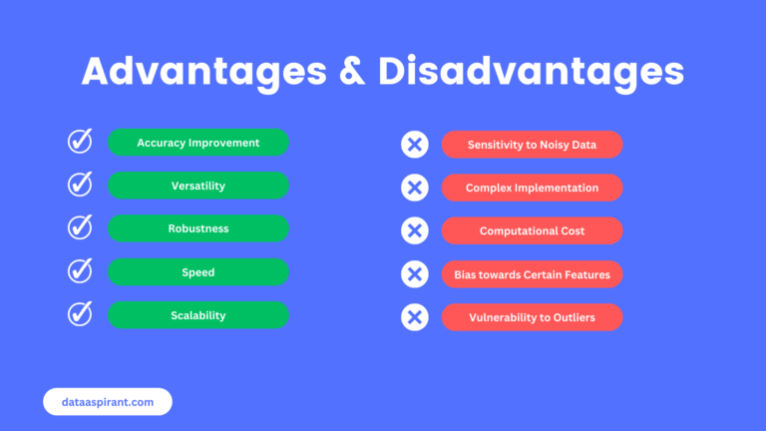
Advantages and Disadvantages of Adaboost

